Slide 1
ONE Field services RISK RANKING
2025 OFS Risk Ranking: Active & Proactive Focus
Mohamed Elnagdi : Services EHS coe Risk Manager

Slide 2

Risk Ranking Process: Data Collection
Review of Hazard Categories (Source: Gensuite )
Specific Period (Jan 2025 to Dec 2025)
Data include:
  I&I including levels A,B,C and D
  PSE and Near Misses
  Concern Reports (Negative / Positive/ Stop Work/ Escalated to ATS)
  Action Tracking System
  Potentially Severe Events

Slide 3
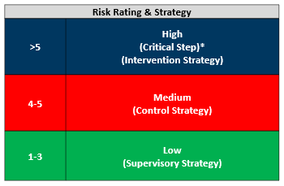
Risk Ranking and Strategy
Strategic action Refer to the Risk management procedure TRA Tab (Q)
If the risk ranking >5 Blue an intervention strategy is required Like: Examples below
(Risk Reduction Project required and 3-month action plan developed to reduce risk level. Input to Strategic Blueprint review)
If the risk ranking is 4-5 Red Control strategy required like (SMART actions developed to reduce risk level)
If the risk ranking is 1-3 Green Supervisory Strategy
( Management oversight , Task briefing SWAT etc )

Slide 4
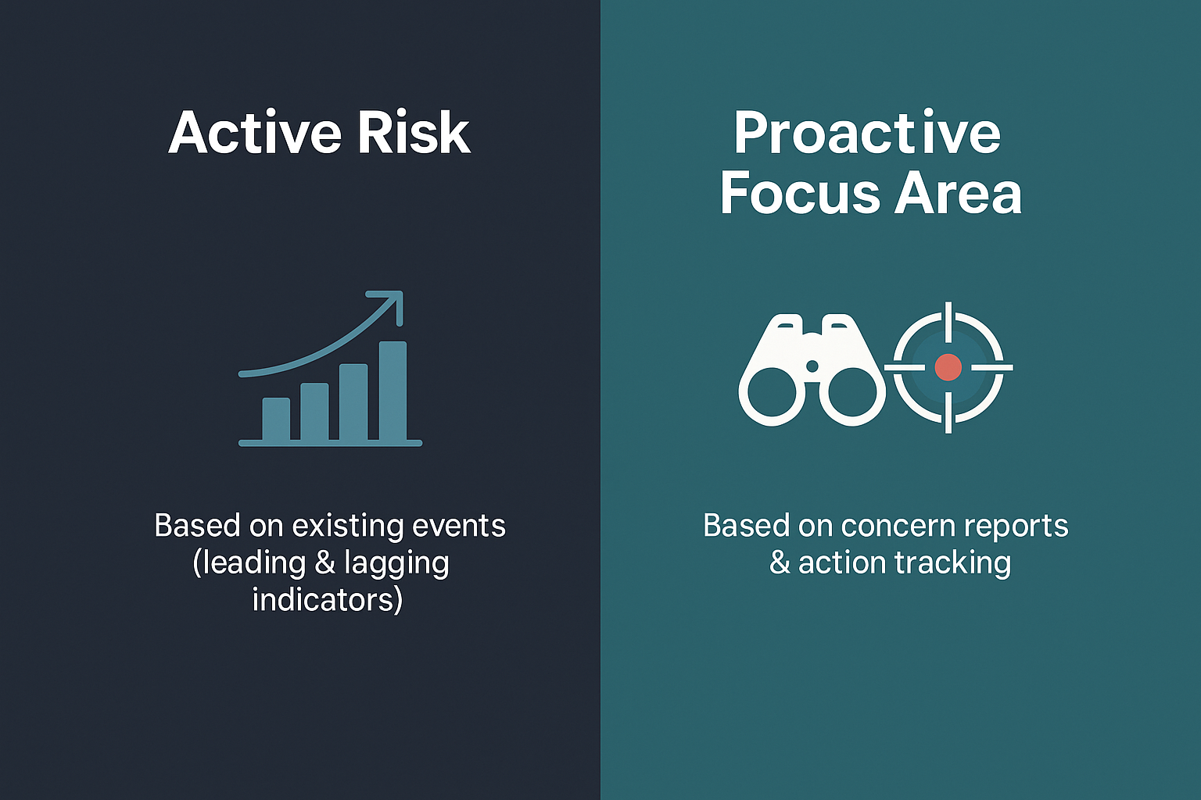
Enhanced Risk Ranking Tool
Active Risk Ranking / Profiling – based on historical Leading / Lagging data
Automated Risk Scoring: Automatically calculates risk scores and ranks hazards using standardized logic in Excel.
Consistent Record Keeping: Maintains historical data and trends for each hazard to support Regional Injury Prevention Plans ( IPP )
Proactive Ranking / Profiling -Using Leading indicator data only
Using Concern Report contributions to signal emerging risks.
Using ATS data to prioritize attention areas early.
Resources Needed:
Gathering the necessary data requires dedicated time to review Gensuite data, categorize the hazards, and incorporate the information into the enhanced tools.

Slide 5
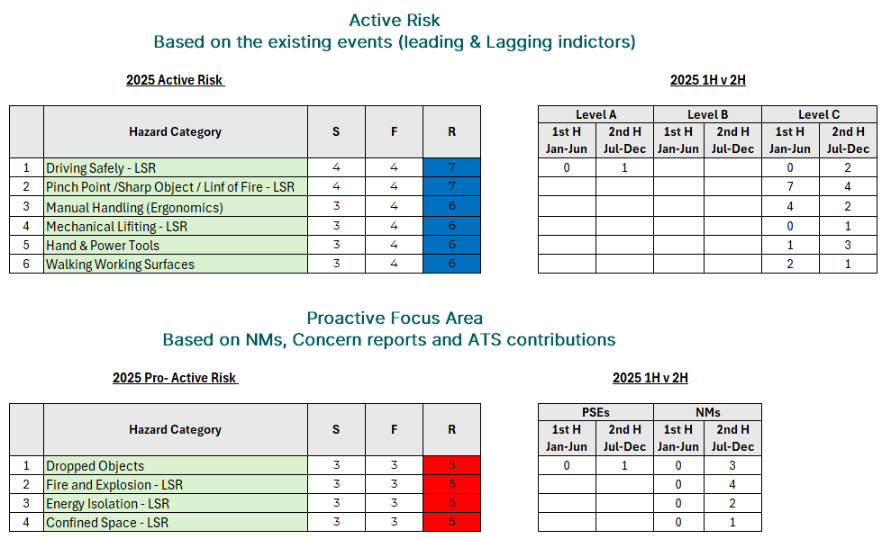
Risk Ranking Process: Global top High-Risk Activities
When reviewing the recordable exposure trends between the first half and second half of 2025, we can see clear improvement across several key hazard areas. Categories such as
Line of Fire,
Manual Handling (Ergonomics), and
Walking/Working Surfaces
show a positive shift, indicating that ongoing preventive actions and stronger field awareness are helping to reduce recordable-driven risk by 50%.
On the other hand, we also observed that exposure remained very high in Driving Safety, Mechanical Lifting and Hand& Power tools.
In addition, the proactive focus areas were selected to ensure representation across each region, using a consistent calculation based on Near Misses, Concern Reports, and ATS contributions.
Based on this prioritization methodology, Dropped Objects emerged as the highest triggering hazard category. This is followed by Fire and Explosion prevention, Energy Isolation (LOTO), and Confined Space.

Slide 6
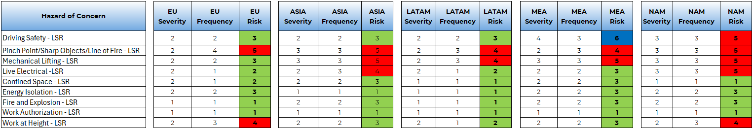
Global Life Saving Rules Risk Profile: Embedded Controls and Critical Focus
This view summarizes the Life Saving Rules risk ranking and shows where controls are effective and where reinforcement is still needed.
Confined Space, Energy Isolation, Fire and Explosion, and Work Authorization are largely in the green zone across most regions, indicating strong control implementation.
However, some exposures remain elevated. Driving Safety is higher in MEA. Pinch Points / Line of Fire stays in the red zone across All the region. Mechanical Lifting also remains medium in Asia, LATAM, MEA, and NAM. Live electrical Medium in ASIA and NAM. W&H Medium in EU and NAM
Overall, while several LSR defenses are well embedded, targeted and focus is still required in these key exposure areas to ensure consistent global performance.

Slide 7
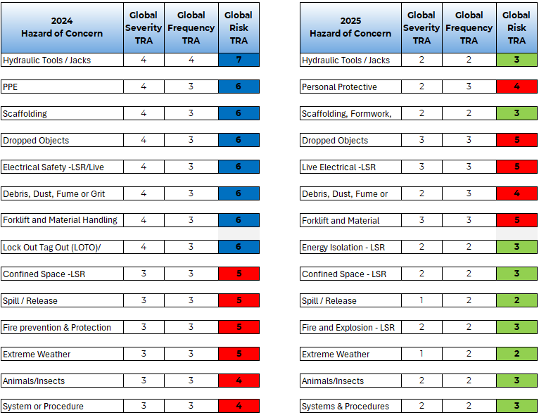
Risk Register 2024 v 2025 Continuous improvement
Comparing 2024 to 2025, the risk matrix clearly demonstrates a significant improvement in our global risk exposure profile.
In 2024, a large proportion of our key hazards were positioned in the blue high/critical zone (risk ranking >5), which required immediate intervention strategies, including Risk Reduction Projects and structured 3-month action plans.
By 2025, the distribution has shifted noticeably, with most hazards now moving out of the critical blue range and into the red medium and green low categories. This transition reflects stronger preventive controls, reduced workforce exposure, and more consistent implementation of Life Saving Rules across operations.

Slide 8
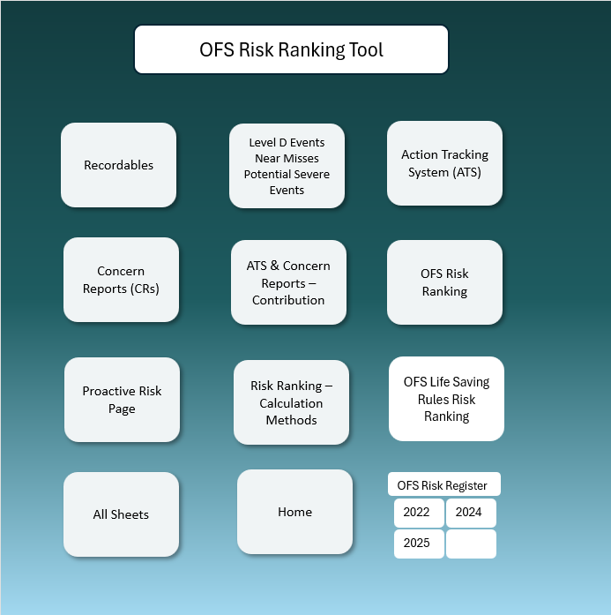
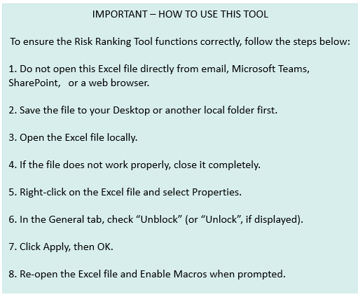
Final OFS Risk Ranking Tool
Overview and User Guidance

Slide 9

نحن
Nosotros somos
мы
Wir sind
Chúng tôi là
Nous sommes
Táimid
Είμαστε
我们是
Nós somos
אנחנו
우리는
We are
ние сме
私たちです
Wij zijn
Mes esame
Jesteśmy
Mi vagyunk
My jsme
اسان آهيون
Biz
Hum hai
Amra achi
Notes:
We are GE Vernova

